Slide 1
effect of signal noise on the learning capability of an artificial neural network
Juan Jaime Vega Castro, Ma. del Rocío Reynoso Vallecillo and Humberto Carrillo Calvet
e-mail: jjvc@nuclear.inin.mx

Slide 2
Index
Introduction
Digital pulse-shape analysis and Bragg curve spectroscopy
Artificial neural networks
Pattern representation and ANN architecture
Results

Slide 3
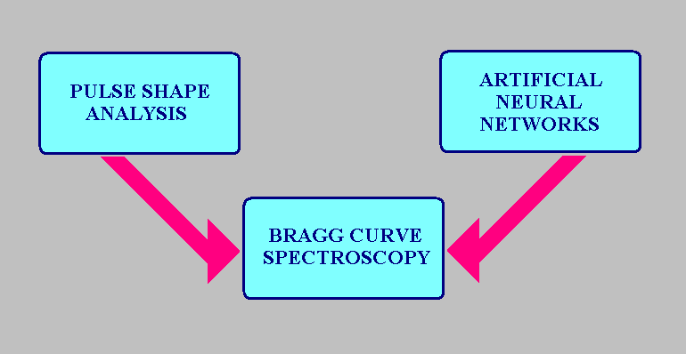
1. Introduction
Digital Pulse Shape Analysis (DPSA) by artificial neural networks (ANN) is becoming an important tool to extract relevant information from digitized signals in different areas.

Slide 4
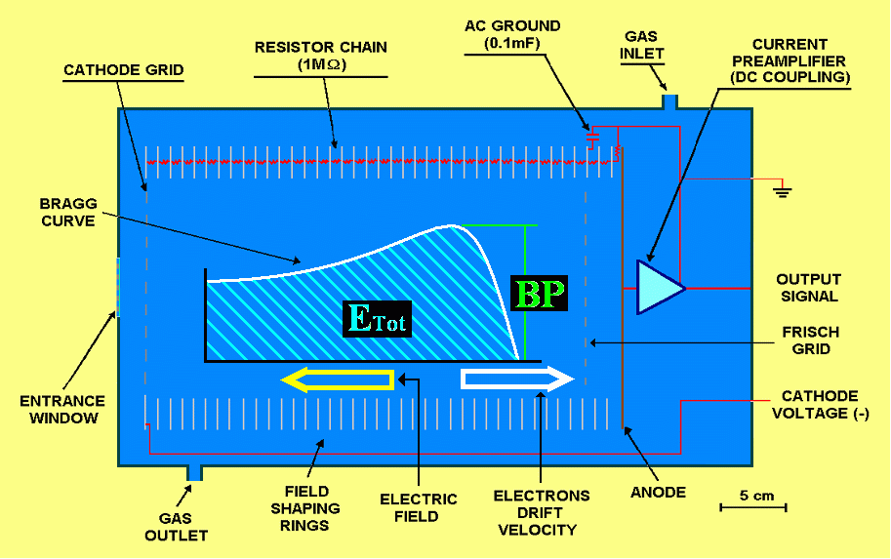
Bragg curve ≡ S(E) = dE/dx
Bragg curve spectroscopy has been a two parameter technique [1-5].

Slide 5
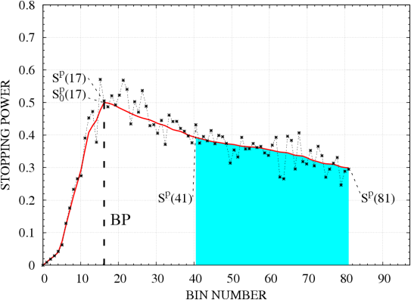
Nowadays, Digital Pulse Shape Analysis techniques (DPSA) have been applied to BCS in order to implement a versatile particle identification [6-11].

Slide 6
DPSA is a complex task.
Requiring new and powerful computational paradigms.
Option: ANN using back-propagation as pattern identifier of synthetic BCs [6-8].
Plus early stopping [12] in order to take care of overtraining, which is a known problem during the training stage of an ANN [12-26].
This was implemented in Refs. 6-8 to analyze synthetic noisy BCs.
A synthetic noise component was added to simulate any possible source of noise that normally goes with the experimental signal of interest.
Overtraining, i.e., overfitting the data by the ANN during training was observed.

Slide 7
This contribution is on the effect of overfitting for noise component sizes equal to 3%, 4%, 7% and 8%, and comparing the results with the 6 cases studied in [8] corresponding to 1%, 2%, 5%, 6%, 9% and 10%.

Slide 8
2. DPSA and Bragg curve spectroscopy

Slide 9
Fig. 1. Plot of an ideal synthetic BC (solid line) together with a simulated synthetic experimental BC (dots), including a fast changing component that takes into account any possible source of experimental noise (9%). The training D^{T} and validation D^{V} data sets were built using BCs of a length consisting of at least 41 bins (cyan range).

Slide 10
3. Artificial neural networks
We used the early stopping technique to prevent overtraining; hence keeping the ANN generalization capability (the ability to identify patterns from the validation rather than the training data set).
This procedure is based on searching for a minimum in the validation error curve, E^{V}(ρ), despite the corresponding training error curve, E^{T}(ρ), keeps on decreasing. These curves are defined as:
and
(1)

Slide 11
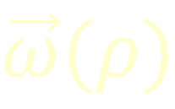
D^{T} and D^{V} are the training and validation data sets consisting, each one, of 100 patterns or instances of BCs belonging to every one of the 451 analyzed classes = 11 BPs heights times 41 E_{tot} values.
K =45,100 is the number of patterns in D^{T} or D^{V}.
is the ANN output for pattern p after ρ training epochs.
is the weight array after training the ANN for ρ epochs.
target value.

Slide 12
We chose the back-propagation learning law including a momentum term [27], since it has proved to be efficient for pattern identification tasks [6-8, 28-29].
Learning rate
Update number
Error term
Neuron output
The initial values of the weight array components, , are chosen according to a uniform random distribution over the interval [-0.5, 0.5].
12

Slide 13
4. Pattern representation and ANN architecture
To simplify the analysis, we selected BCs with energies larger than their BP’s energy, which, for all our ideal synthetic BCs, corresponds to the 17th bin. This is, we selected BCs corresponding to the 41 largest total energies only, the shaded region.
The training and validation sets are defined as:
and
(2)

Slide 14
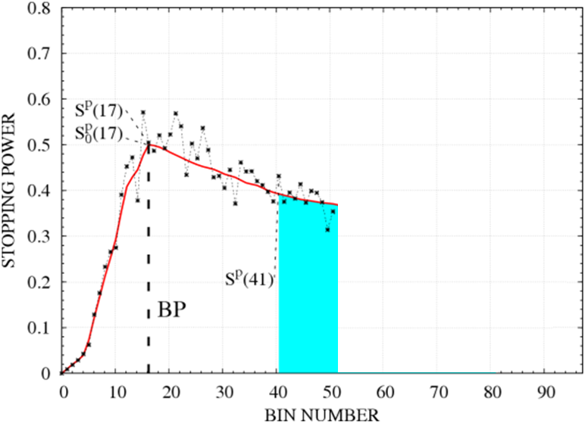
follows a Gaussian distribution
Fig. 2. Bragg curve ≡ for n = 51.

Slide 15
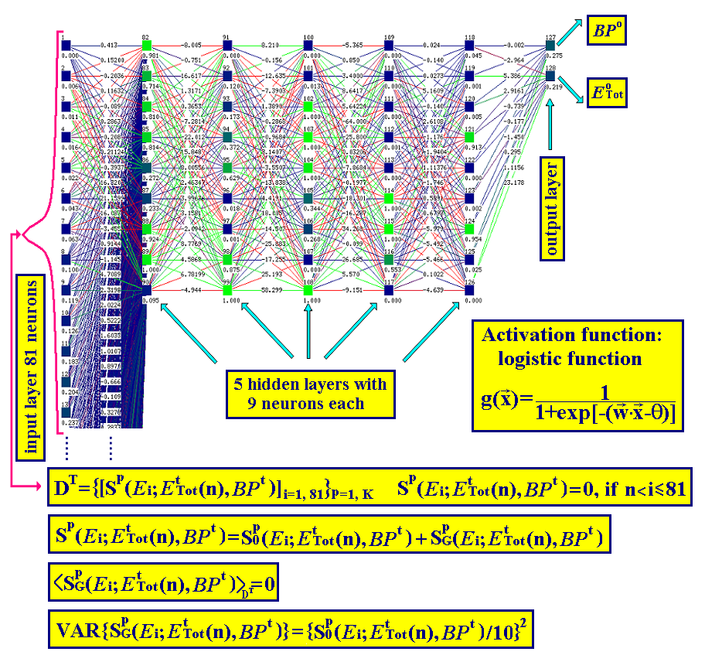
Fig. 3. ANN architecture: input layer (81 neurons), 5 hidden layers (9 neurons each) and an output layer of 2 neurons. is the neuron input array with information coming from all neurons from the previous layer and pondered by the weight array, , associated with the links that carry each one of the inputs, and θ is the neuron bias value.

Slide 16
Table 1
ANN training and validation data set parameters
PARAMETER | VALUE
Learning law | Back-propagation with momentum term
ANN size | Input layer: 81 units 5 hidden layers: 9 units each Output layer: 2 units Fully connected
α = learning rate | 0.3
μ = momentum term | 0.15
ω = initialization range | [-0.5,0.5]
Order of pattern presentation | Shuffle
Activation function | Sigmoid
Neurons update order | Serial order
D^{T} and D^{V} data sets | 100 samples of each one of the 451 classes: (11 BP values) x (41 E_{Tot} values)
CPU time (SUSE LINUX) Intel Pentium 4, 1.7 GHz | 30 days of execution time for a training of 1,000,000 epochs

Slide 17
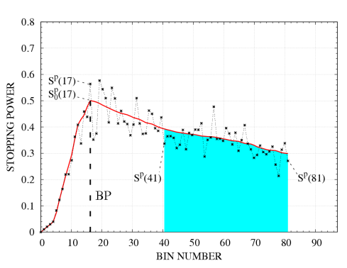
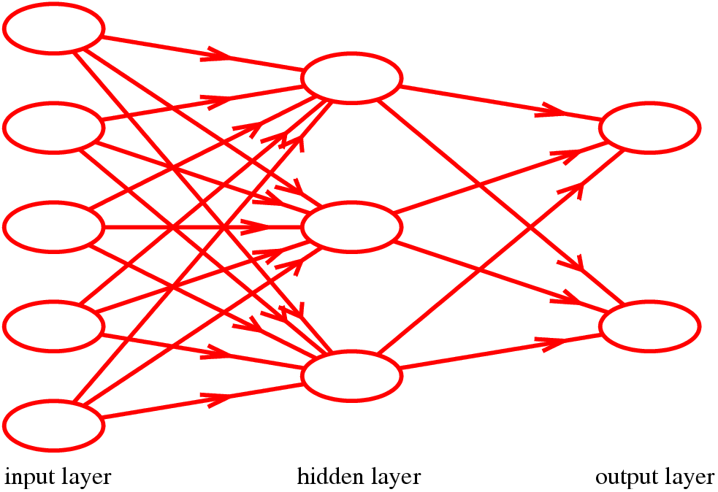
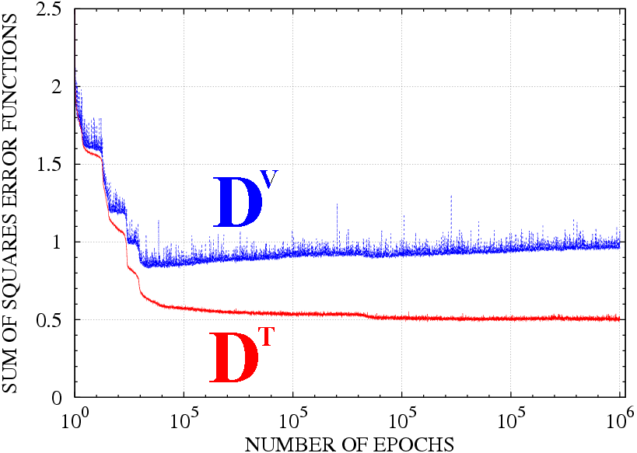
Adaptation of the ANN to the data through a slow modification of its weight array, , guided by a supervised learning algorithm (back-propagation).
D^{T}: training data set
Forward pass (prediction)
Backward pass (learning)
45,100 BCs for ρ = 1
ρ = 1
training epochs or adaptations
45,100 BCs for ρ_{min}
ρ = ρ_{min}
Trained ANN
Stop training

Slide 18
5. Results
We trained 10 ANNs corresponding to 10 different values of the noise to signal ratio (N/S): 1%, 2%, … and 10%.
e = 0.01, 0.02, …., 0.1
BP = 0.25, 0.275, …, 0.5
E^{Tot}(40), E^{Tot}(41), …, E^{Tot}(80)

Slide 19
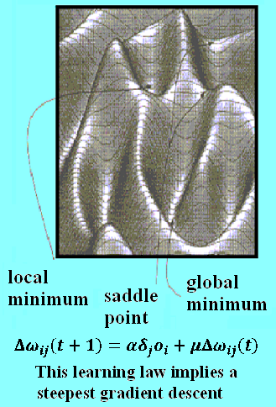
Due to the weight array random initialization, may fall in an arbitrary point in weight space, strongly perturbing the ANN learning evolution, as monitored by the shapes of the error curves E^{T}(ρ) and E^{V}(ρ). But, eventually, E^{V}(ρ) will reach its minimum value.
Our expectation: The minimum E^{V}(ρ_{min}) as a function of the N/S ratio will show a general monotonic increasing trend, which might be modulated by the ANN weight array random initialization.

Slide 20
Next, we present the error curves E^{T}(ρ) and E^{V}(ρ) for N/S ratios equal to 1%, 2%, … and 10%.

Slide 21
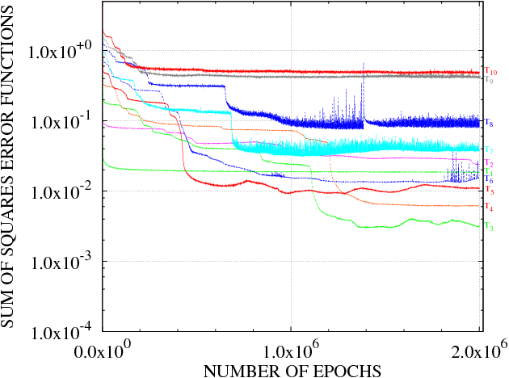
Fig. 4a. Training error curves, E^{T}(ρ), corresponding to N/S ratios equal to 1%, 2%, …, and 10%.

Slide 22
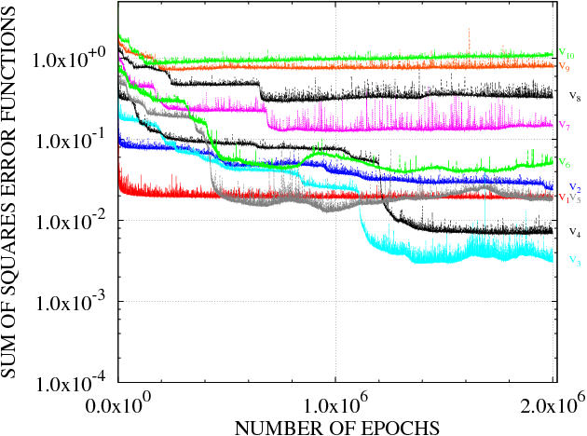
Fig. 4b. Validation error curves, E^{V}(ρ), corresponding to N/S ratios equal to 1%, 2%, …, and 10%.

Slide 23
Comparing the 1% and 2% error curves, to the 3% and 4% curves, we see that they have not attained their minimum value yet after 2,000,000 epochs.

Slide 24
This can be verified by looking at the corresponding BP vs. E_{Tot} scatter plots shown in Figs. 5a-j.

Slide 25
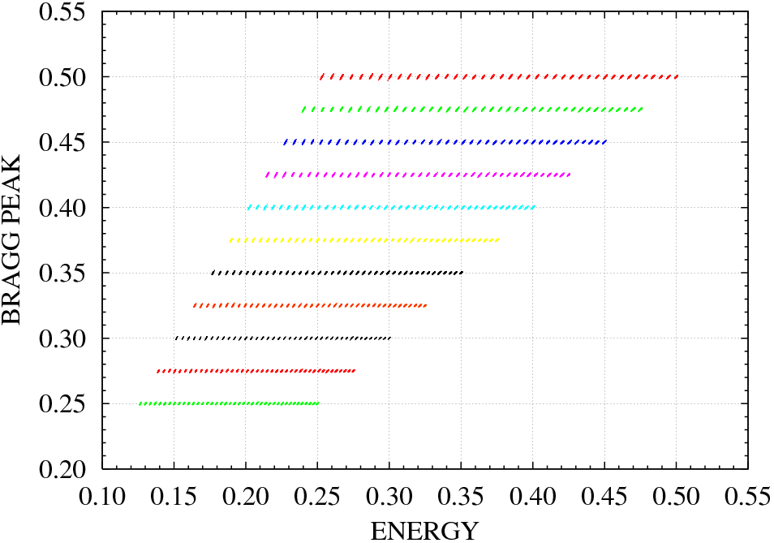
Fig. 5a. BP vs. E_{Tot} scatter plot corresponding to N/S=1% and 2,000,000 training epochs.

Slide 26
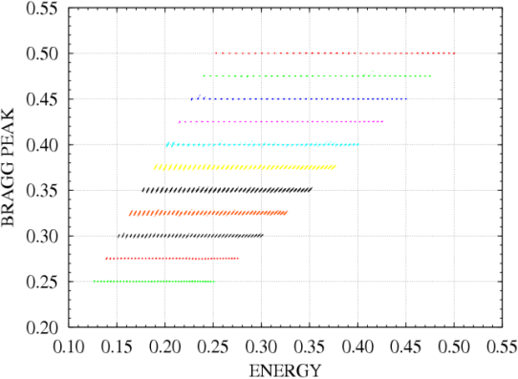
Fig. 5b. BP vs. E_{Tot} scatter plot corresponding to N/S=2% and 2,000,000 training epochs.

Slide 27
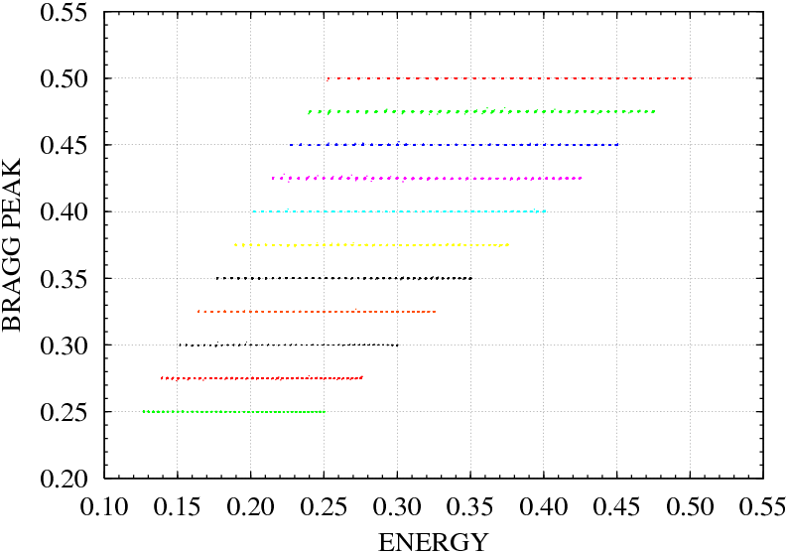
Fig. 5c. BP vs. E_{Tot} scatter plot corresponding to N/S=3% and 1,409,000 training epochs.

Slide 28
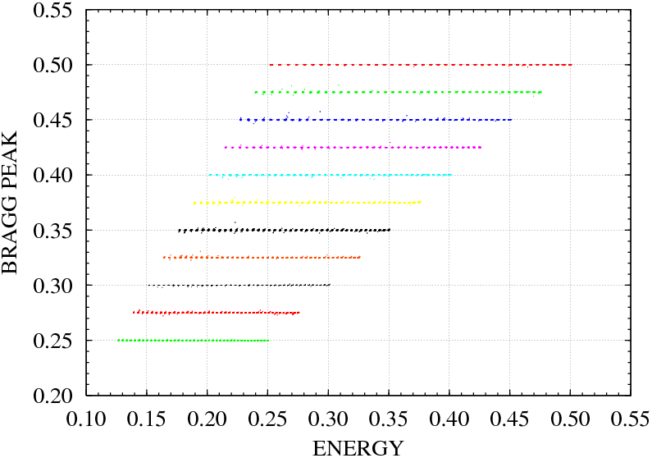
Fig. 5d. BP vs. E_{Tot} scatter plot corresponding to N/S=4% and 1,874,000 training epochs.

Slide 29
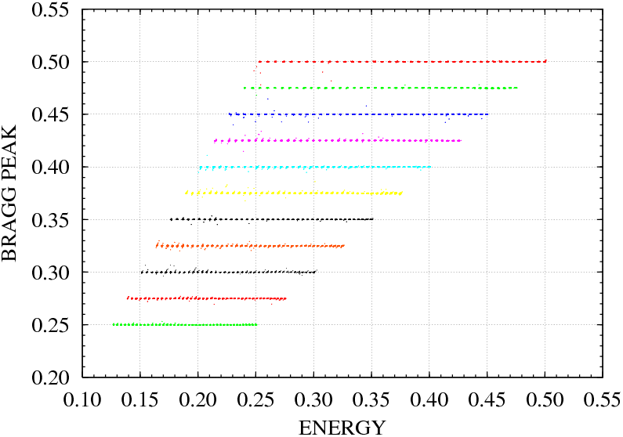
Fig. 5e. BP vs. E_{Tot} scatter plot corresponding to N/S=5% and 960,000 training epochs.

Slide 30
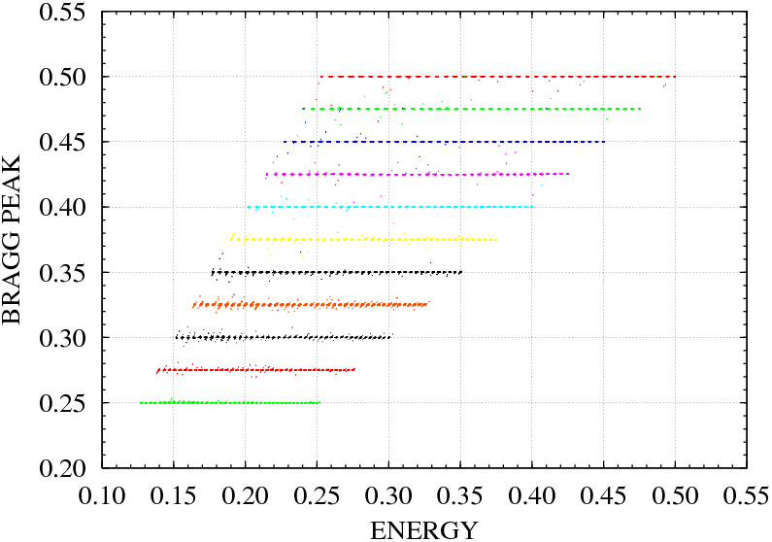
Fig. 5f. BP vs. E_{Tot} scatter plot corresponding to N/S=6% and 1,308,000 training epochs.

Slide 31
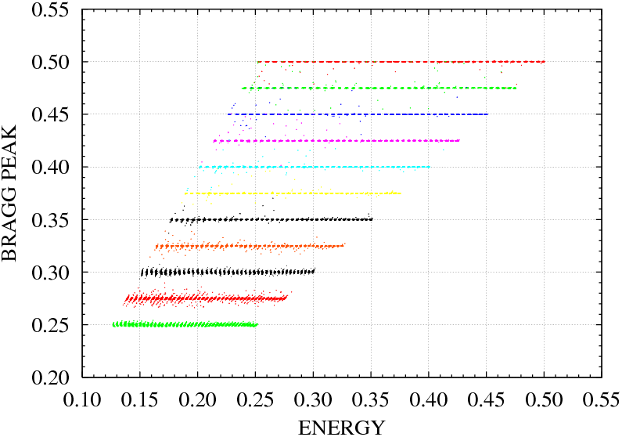
Fig. 5g. BP vs. E_{Tot} scatter plot corresponding to N/S=7% and 758,000 training epochs.

Slide 32
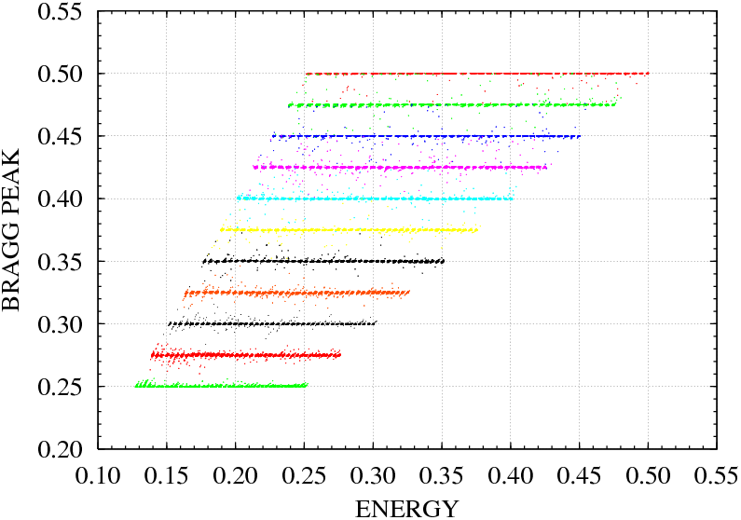
Fig. 5h. BP vs. E_{Tot} scatter plot corresponding to N/S=8% and 777,000 training epochs.

Slide 33
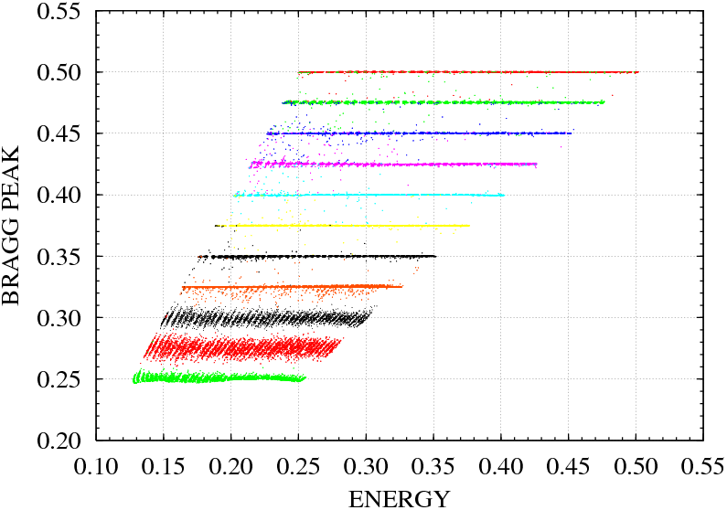
Fig. 5i. BP vs. E_{Tot} scatter plot corresponding to N/S=9% and 2,000,000 training epochs.

Slide 34
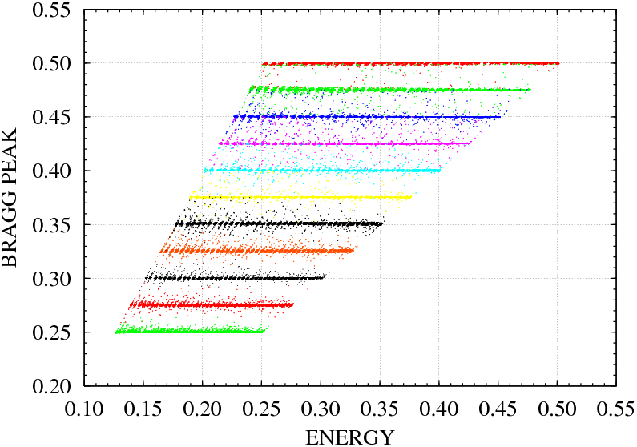
Fig. 5j. BP vs. E_{Tot} scatter plot corresponding to N/S=10% and 196,000 training epochs.

Slide 35
1% noise after 2,000,000 training epochs
The ANN is capable of a good classification. But it seems that the sizes of the spots corresponding to each one of the different classes could be made smaller if one keeps on training the ANN.

Slide 36
2% noise after 2,000,000 training epochs
It has learnt all the groups reasonably well, but not with the same accuracy, suggesting that it also requires additional training. This does not happen to occur for larger noises.

Slide 37
9% noise after 2,000,000 training epochs
Apparently, the 9% case also demands additional training.

Slide 38
Consequently, we trained the corresponding ANNs some additional epochs:
1% noise up to 10,000,000 epochs,
2% noise up to 5,000,000 epochs,
9% noise up to 3,000,000 epochs.
In Fig. 6, we present E^{T}(ρ) and E^{V}(ρ) error curves for these 3 cases.
The 1% case could not reach a minimum value after 10,000,000 epochs.
The 2% case reach its minimum value at 3,050,000 epochs.
The 9% case reach its minimum value at 2,515,000 epochs.

Slide 39
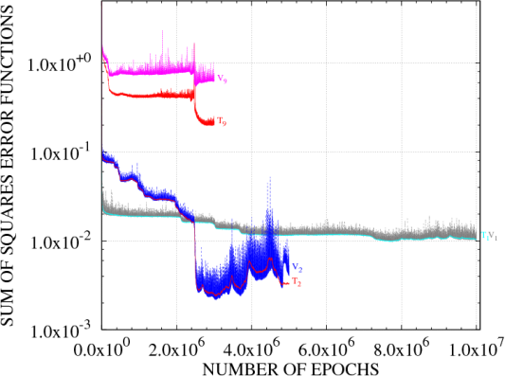
minimum at 2,515,000
minimum at 3,050,000
Fig. 6. E^{T}(r) and E^{V}(r) error curves corresponding to N/S values equal to 1%, 2% and 9%. In the 1% case, we see how long it takes the ANN to extract the learnable information that , in the other cases, is masked as the N/S ratio grows.

Slide 40
The 1% error curve could not reach a smaller minimum value than those reached by the 2%, 3% and 4% error curves.
From the smoothness of the 1% training error curve, after 100,000 epochs, we deduce that the training effect induces a very slow evolution along the error surface, so, to accelerate the approach to its minimum value, the ANN training was started over beginning at 100,000 epochs but changing the learning factor from 0.3 to 5.0. See Fig. 7.

Slide 41
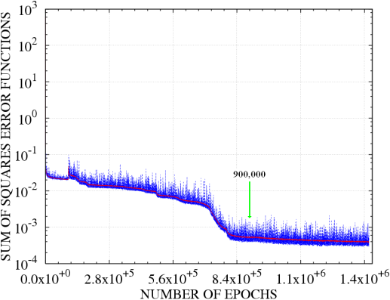
100,000 (0.3 epochs) + 1,320,000 (5.0 epochs) ~ 22,100,000 (0.3 epochs)
Quite small value equal to 0.0006, smaller than any other minimum value.
900,000 ~ 13,433,333 (0.3 epochs)
Fig 7. E^{T}(r) and E^{V}(r) error curves corresponding to a 1% N/S ratio. The learning rate parameter was changed from 0.3 to 5.0 after 100,000 training epochs.

Slide 42
The BP vs. E_{Tot} scatter plots obtained in the 1%, 2% and 9% cases are shown in Figs. 8a-c.

Slide 43
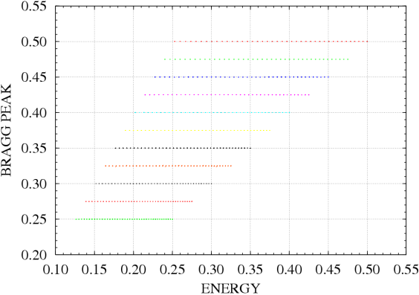
1% N/S BP vs. E_{Tot} validation scatter plot
Fig. 8a. After 900,000 epochs, the ANN has reached a small validation error value equal to 0.0006, using a learning factor equal to 0.3 from 0 to 100,000 epochs and equal to 5.0 from 100,000 on.

Slide 44
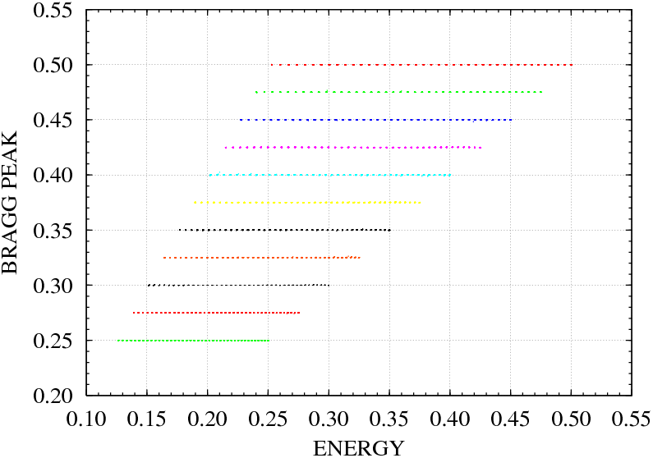
2% N/S BP vs. E_{Tot} validation scatter plot
Fig. 8b. The minimum is reached at 3,050,000 epochs.

Slide 45
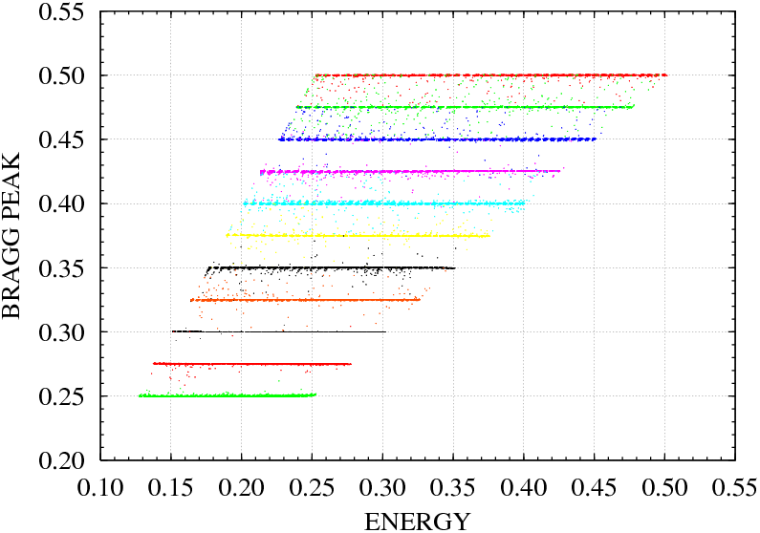
9% N/S BP vs. E_{Tot} validation scatter plot
Fig. 8c. The minimum is reached at 2,515,000 epochs.

Slide 46
Table 2.
Summary of the number of training epochs it took the validation error curves E^{V} (ρ) to reach their minimum value. Also presented are the minimum average values AveE^{V}(ρ_{min}) and their standard deviations, StdE^{V}(ρ_{min}), calculated in a small neighborhood of 10,000 epochs around ρ_{min}.
N/S (%) | ρ_{min} (epochs) | AveE^{V}(ρ_{min}) | StdE^{V}(ρ_{min})
1 | 13,433,333 | 6.3000E-04 | 2.6000E-04
2 | 3,050,000 | 2.4000E-03 | 2.2000E-04
3 | 1,409,000 | 3.4000E-03 | 6.0000E-04
4 | 1,874,000 | 7.1000E-03 | 5.1000E-04
5 | 960,000 | 1.3000E-02 | 8.2000E-04
6 | 1,308,000 | 4.0000E-02 | 6.0000E-04
7 | 758,000 | 1.3000E-01 | 2.0000E-03
8 | 777,000 | 3.0000E-01 | 2.6000E-02
9 | 2,515,000 | 5.7000E-01 | 2.0000E-02
10 | 196,000 | 8.7000E-01 | 2.7000E-02
AveE^{V}(ρ_{min}) is a monotonic increasing function of N/S

Slide 47
Since AveE^{V}(ρ_{min}) is a monotonic increasing function of N/S, we will try a straight line least-square fit to the ln[E^{V}(ρ_{min})] vs. N/S data.
Result of a straight line least-squares fit to the ln[E^{V}(ρ_{min})] vs. n data:
where
and n is the N/S ratio. The regression coefficient value of the least-square fit is r = 0.995. See Fig. 9.
(3)

Slide 48
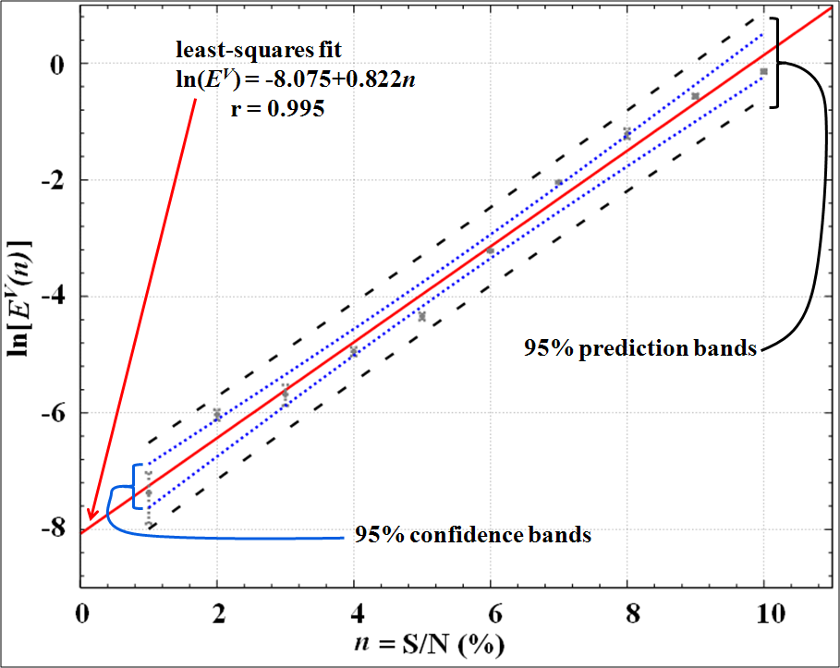
Fig. 9. Straight line least-square fit of ln[E^{V}(ρ_{min})] vs. n data.

Slide 49
The uncertainty bars shown in Fig. 9 are displayed just to give us an idea of the local variability of E^{V}(ρ) in a neighborhood around ρ_{min}.
There is also a source of global variability of E^{V}(ρ_{min}) around its average value, i.e., the minimum values obtained when repeating the whole training of the ANN several times.
The 10% N/S case is the only one for which we could estimate the size of this global uncertainty. We repeated the ANN training 13 times, see Fig. 10, allowing us to estimate their average value and standard deviation.

Slide 50
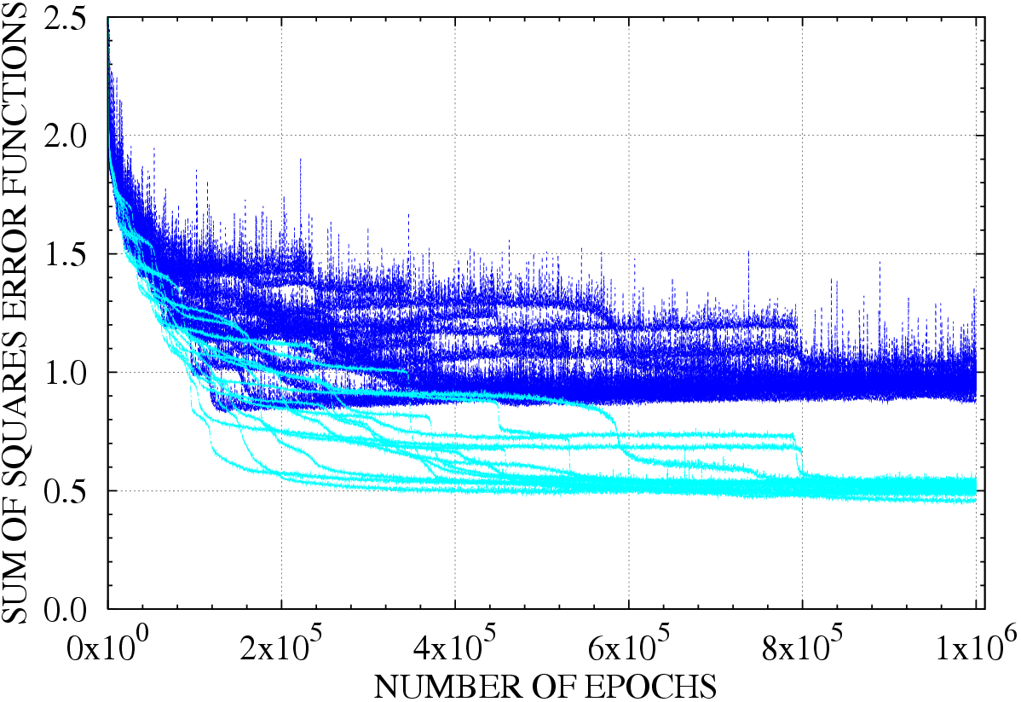
Local values
Global values
[186,000, 206,000]
Fig. 10. Training and validation sum of squares error functions E^{T}(ρ) (cyan) and E^{V}(ρ) (blue), corresponding to 13 different initializations of the ANN weight array .

Slide 51
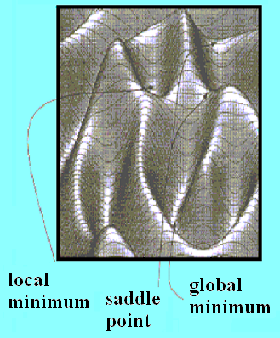
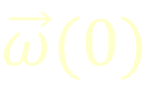
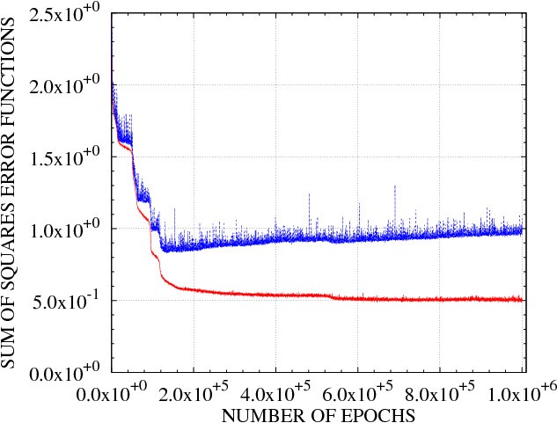
The global uncertainty in E^{V}(ρ_{min}) origins from the random initialization of the network that determines, globally, the path the network will follow in its learning adaptation in search for the minimum error.
Adding the two contributions in quadrature we get an uncertainty equal to 0.031.
The local uncertainty in E^{V}(ρ) around ρ_{min} origins from a random fluctuation component in the weight array adaptation, which is unable to alter the general shape of the path followed by the network in its search for the minimum.

Slide 52
The straight line ln[E^{V}(n)] = β₀ + β₁n describes how the noise, n, present in the signals or patterns to be identified contributes to set limits to the learning capability of an ANN.
We may go back and look instead at:
(4)
where A = exp(b₀) = 3.11x10⁻⁴. See Fig 11.

Slide 53
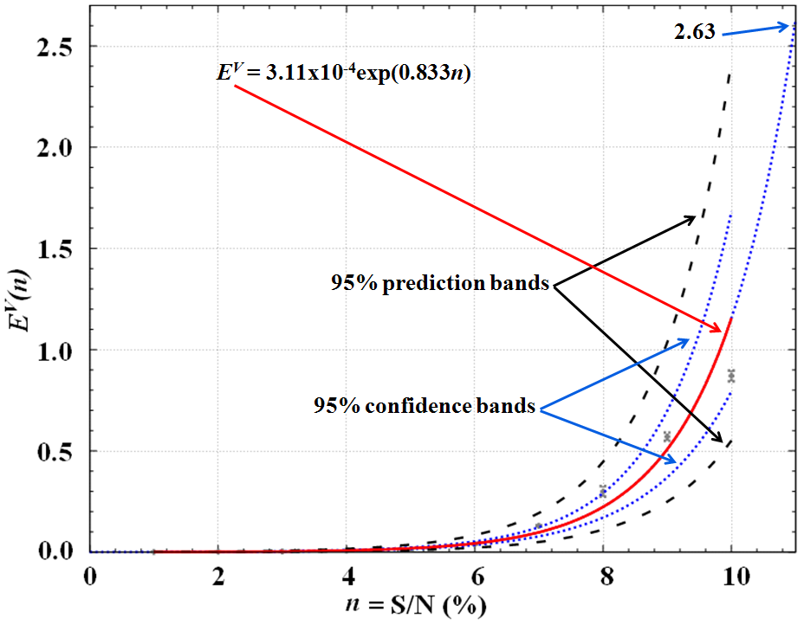
Fig. 11. Plot of E^{V}(n) = 3.11x10⁻⁴exp(0.833n) obtained from a straight line least-square fit to the ln[E^{V}(n)] vs. n data. The 95% confidence bands are indicated by the dotted lines and the 95% prediction bands are indicated by the dashed lines.

Slide 54
EFFECT OF NOISE

Slide 55
For small N/S values, the ANN takes longer to learn its task, i.e., the E^{V}(ρ) error curve reaches its minimum value slowly, requiring a large number of training epochs.
N/S (%) | ρ_{min} (epochs) | AveE^{V}(ρ_{min}) | StdE^{V}(ρ_{min})
1 | 13,433,333 | 6.3000E-04 | 2.6000E-04
2 | 3,050,000 | 2.4000E-03 | 2.2000E-04
3 | 1,409,000 | 3.4000E-03 | 6.0000E-04
4 | 1,874,000 | 7.1000E-03 | 5.1000E-04
5 | 960,000 | 1.3000E-02 | 8.2000E-04
6 | 1,308,000 | 4.0000E-02 | 6.0000E-04
7 | 758,000 | 1.3000E-01 | 2.0000E-03
8 | 777,000 | 3.0000E-01 | 2.6000E-02
9 | 2,515,000 | 5.7000E-01 | 2.0000E-02
10 | 196,000 | 8.7000E-01 | 2.7000E-02
General trend: ρ_{min} grows smaller with the N/S ratio
55

Slide 56
This general trend springs from the fact that the different tasks are not equivalent, and this is a result of the limiting learning effect due to the noise present in the signals.
At low N/S values, there are subtle features that are learnable, but, due to the noise masking effect, at high N/S values, they cannot be learnt.
This masking effect grows smoothly as a function of n or N/S value. These subtle features, although learnable at low N/S values, are not easy to learn by the ANN, indeed, they demand a large number of training epochs to be learnt.

Slide 57
The decreasing ability to learn subtle features as the parameter n increases is reflected in the diminishing quality of the corresponding BP vs. E_{Tot} scatter plots as the parameter n increases.
1%
4%
6%
10%
57

Slide 58
1%
10%
The spreading of the 100 (BP, E_{Tot}) values predicted by the ANN around the corresponding tutorial value for a fixed class, is determined by the number of features the ANN may extract during the learning or training stage.
58

Slide 59
Subtle features take longer to be learnt, but, as far as the N/S value is small enough so as not to mask those particular features, they will be learnt by the ANN eventually.
Hence, for small N/S values, the error surface is quite smooth once the ANN has learnt the patterns’ gross features. This is why we were successful when, in the 1% N/S case, we replaced the original 0.3 learning factor by a much larger value equal to 5.0 and the ANN learned with no problem.
1%

Slide 60
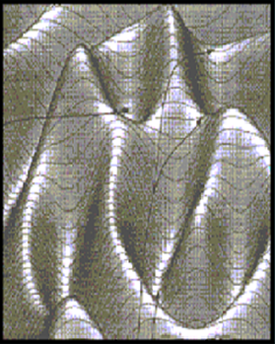
On the other side, a large noise, implies a bumpy error surface, preventing the learning rule to detect shallow minima corresponding to subtle features.
Visualizing the learning process as an adaptation or evolution of the ANN configuration point in weight space, which when using a back-propagation learning law, is equivalent to following the steepest descent path [30]
then overtraining may be accounted for by those regions in weight space where the steepest descent path is due to structures in the error surface that have nothing to do with the relevant pattern features, but rather they are produced by the concomitant signal noise, see Fig. 12.

Slide 61
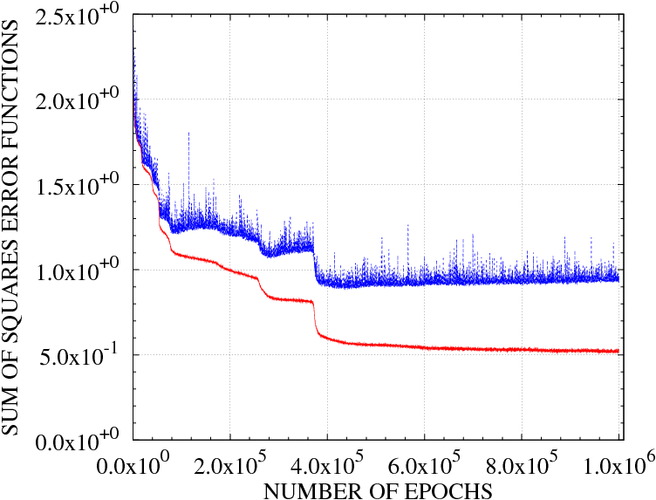
a feature is learnt (large down step)
Eventually, the ANN will get to a point where the remaining unextracted or unlearnt features cannot dominate the shape of the error surface in weight space any more. Noise will take over from that point on as the error surface shape defining factor, i.e., overtraining will dominate the learning process for that point on.
Once a feature is learnt by the ANN, the shape of the error surface is again dominated by noise and overtraining will onset for a while, until the ANN configuration point gets to a new region where once more the shape of the error surface is dominated by the new feature ready to be learnt.
ANN feature learning occurs when the configuration point in weight space traverses regions where the steepest descent path is pronounced and produced by a particular feature of interest.
noise learning ≡ overfitting
(E^{V}(ρ) starts going up)
Fig. 12. Training and validation error curves corresponding to N/S = 10% showing the effect of noise or overtraning.

Slide 62
The idea is to stop the training process at that point.

Slide 63
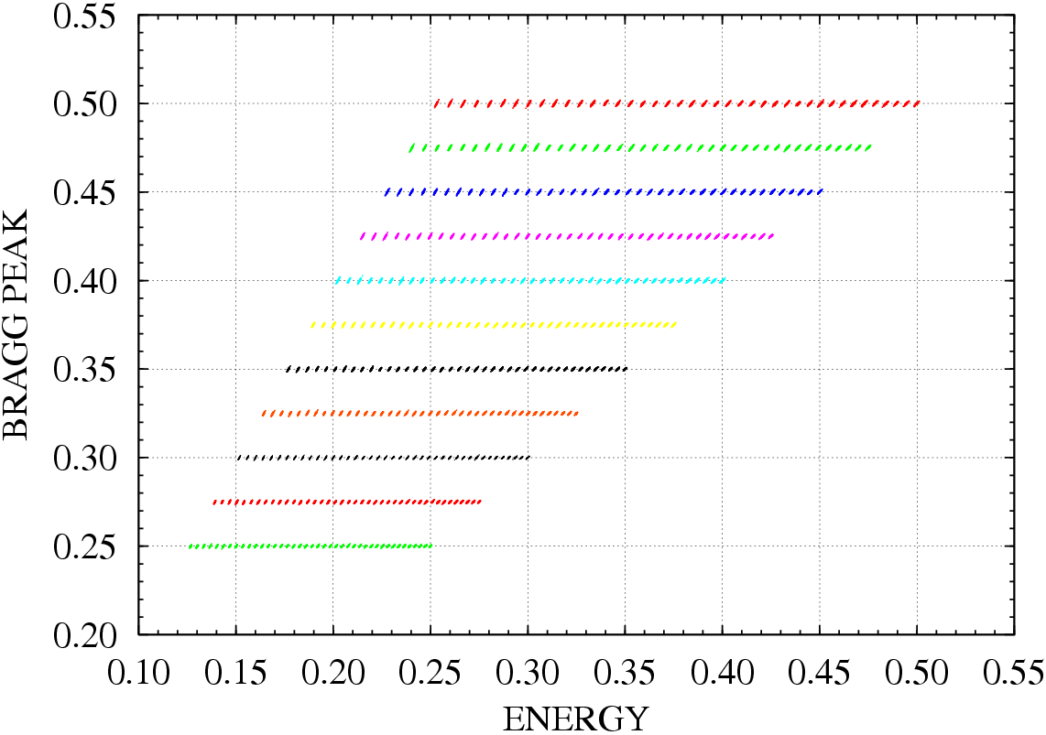
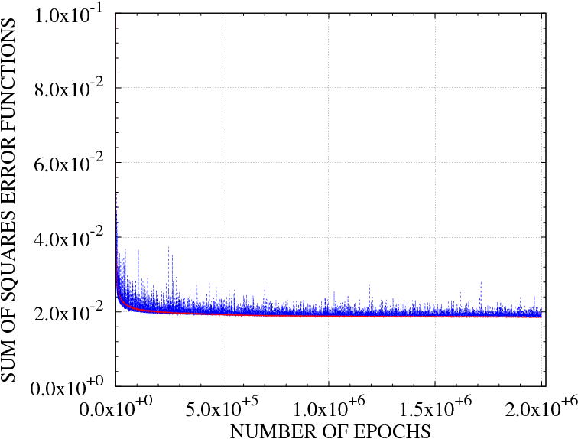
From the quality of the 1% N/S BP vs. E_{Tot} validation scatter plot after 100,000 epochs and from the smoothness of its training error curve, it follows that the ANN learnt the gross pattern features after only 100,000 epoch, a small number in comparison to the other N/S ratios. But in order to extract the rest of the pattern features, presumably subtle features, it took the ANN a very large number of epochs.
Both curves stick together
N/S = 1% is so small that overtraining never shown up.
Indeed, the ANN might be still extracting pattern features after a training of 1,420,000 epochs.

Slide 64
It might not be necessary to let the ANN to try to extract all the pattern features, since all one needs to do is to perform a pattern classification, which may be achieved once the ANN has learnt a certain number of pattern features and not all of them necessary.
From a practical point of view, after a training of 100,000 (0.3) + 800,000 (5.0) epochs, the ANN is suited for our pattern classification problem. In fact, the ANN trained for 100,000 (0.3 epochs) might work as well.
We kept on training the ANN because we were interested in observing how it was going to learn the remaining unlearned features, i.e., how its E^{V}(ρ) error curve was going to evolve; allowing us to determine the functional dependence of E^{V}(ρ_{min}) on the size of the noise to signal ratio.

Slide 65
The search for the minimum of E^{V}(ρ) using the steepest descent path depends a lot on the random initialization point, , in weight space. According to the circumstances, a particular initial value may lead the evolution of the ANN through regions corresponding to a slow adaptation path or vice versa.
The 9% case corresponds to the first class, requiring 2,515,000 epochs to get to the minimum, and the 10% case to the second, requiring only 196,000 epochs.
The point is that, although the selected path to get to the minimum may happen to be shorter or longer, there are limits set to the amount of feature extraction that the ANN may learn from a training data set, and those limits are defined by the N/S ratio and not by the path followed to get to the minimum.

Slide 66
THANKS

Slide 67
References
1) C.R. Gruhn, M. Binimi, R. Legrain, R. Loveman, W. Pang, M. Roach, D.K. Scott, A. Shotter, T.J. Symons, J. Wouters, M. Zisman, R.Devries, Y.C. Peng and W. Sondheim, Nucl. Instr. and Meth. 196 (1982) 33-40.
2) A. Moroni, I. Iori, L.Z. Yu, G. Prete, G. Viesti, F. Gramegna and A. Dainelli, Nucl. Instr. and Meth. 225 (1984) 57.
3) M.F. Vinyard, B.D. Wilkins, D.J. Henderson, D.G. Kovar and C. Beck, C.N. Davids and J.J. Kolata, Nucl. Instr. and Meth. A255 (1987) 507.
4) K.E. Rhem and F.L. Wolfs, Nucl. Instr. and Meth. A273 (1988) 262.
5) J.J. Vega, J.J. Kolata, W. Chung, D.J. Henderson and C.N. Davids, Proc. XIV Symposium on Nuclear Physics, Cuernavaca, Mexico, 1991, M. Brandan, ed., World Scientific, Singapore, (1991) 221.
6) J.J. Vega and R. Reynoso, Nucl. Instr. and Meth. B243 (2006) 232.
7) J.J. Vega and R. Reynoso, Rev. Mex. Fís. S 53(3) (2007) 118-124.
8) J.J. Vega, R. Reynoso and H. Carrillo-Calvet, Rev. Mex. Fís. S 54(1) (2008) 22-29.
9) L. Andronenko et al., Preprint PNPI NP-3-1998 Nr. 2217.
10) N.J. Shenhav and H. Stelzer, Nucl. Instr. and Meth. 228 (1985) 359-364.
11) M.N. Andronenko and W. Neubert, Annual report 1998-1999 FZR-271 (1999) 67.
12) C.M. Bishop, Neural Networks for Pattern Recognition, Clarendon Press-Oxford, (1995).
13) C.M. Bishop, IEEE Transactions of Neural Networks 4 (1993) 882.
14) C. Wang, S.S. Venkatesh and J.S. Judd, NIPS’1993 6 eds. J. Cowan, G. Tesauro, J. Alspector, Morgan-Kaufmann, (1994) 303.
15) W.S. Sarle, in Proc. of the 27th Symposium on the Interface of Computing Science and Statistics (1995) 352-360.
16) A.S. Weigend, M. Mangeas and A.N. Srivastava, International Journal of Neural Systems 6 (1995) 373.
C.M. Bishop, Neural Computation 7 (1995) 108.
S. Bös, ICANN’1995 2, ed. by EC2 & Cie, 111.

Slide 68
References
19) S. Bös, NIPS’1995 8, eds. G. D. Touretzky, M. Mozer, M. Hasselmo, MIT Press, (1996) 218.
20) P. Sollich and A. Krogh, in Advances in Neural Information Processing Systems 8, eds. D. S. Touretzky, M. C. Mozer and M. E. Hasselmo, MIT Press, (1996) 190.
21) S. Amari, N. Murata, K.-R. Finke, M. Finker and H. Yang, IEEE Transaction on Neural Networks 8 (1997) 985; and NIPS’1995 8, eds. G. D. Touretzky, M. Mozer, M. Hasselmo, MIT Press, (1996) 190.
22) S. Amari and N. Murata, IWANN’1997, eds. J. Mira, R. Moreno-Diaz, J. Cabestany, Springer, (1997) 284.
23) S. Lawrence and C. L. Giles, IJCNN’00 Vol. 1, eds. Shun-Ichi Amari, C. Lee Giles, Marco Gori, and Vincenzo Piuri, IEEE Press, (2000) 114.
24) P. Domingos, ICML’2000, Morgan Kaufman, (2000) 223.
25) G. N. Karystinos and D.A. Pados, IEEE Transactions on Neural Networks 11 (2000) 1050.
26) R. Caruana, S. Lawrence and C.L. Giles, NIPS’2000 Vol. 13, eds. T. Leen, T. Dietterich, V. Tresp, MIT Press, (2001) 28.
27) A. Zell, G. Mamier, M. Vogt, N. Mache, R. Hübner, S. Döring, K. Herrmann, T. Soyez, M. Schmalzl, T. Sommer, A. Hatzigeorgiou, D. Posselt, T. Schreiner, B. Kett, G. Clemente, J. Wieland, J. Gatter, M. Reczko, M. Riedmiller, M. Seemann, M. Ritt, J. DeCoster, J. Biedermann, J. Danz, C. Wehrfritz, R. Werner, M. Berthold and B. Orsier, “SNNS - Stuttgart Neural Network Simulator, version 4.2”, University of Stuttgart, Institute for Parallel and Distributed High Performance Systems; and University of Tübingen, Wilhem-Schickard-Institute for Computer Science, (1998).
28) J. Damgov and L. Litov, Nucl. Instr. and Meth. A482 (2002) 776.
29) M. Ambrosio, et al., (The MACRO Collaboration), Nucl. Instr. and Meth. A492 (2002) 376.
30) R. Hecht-Nielsen, Neurocomputing, Addison-Wesley Publishing Company, (1990).

